Slide 1
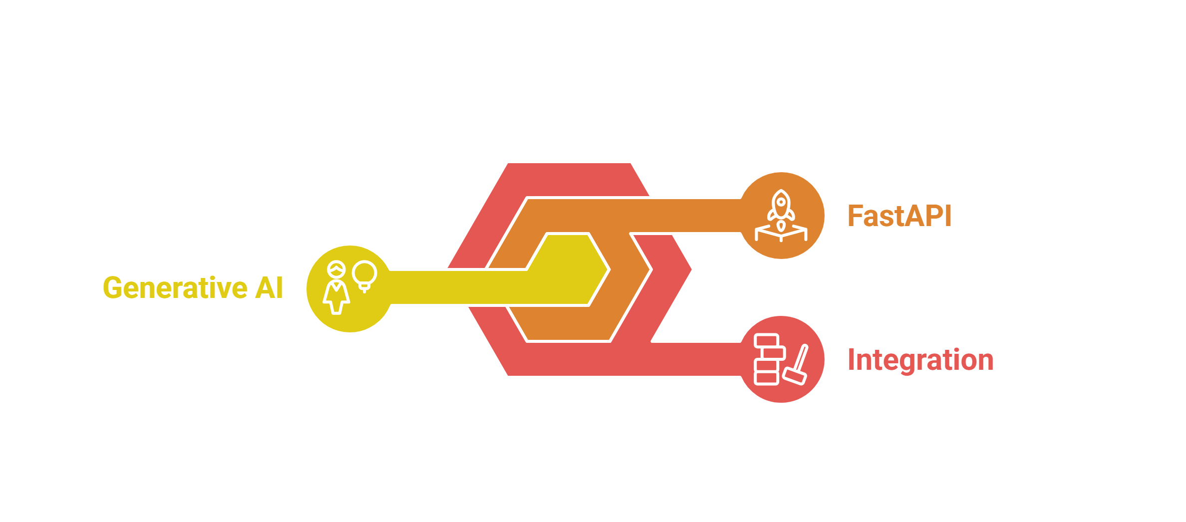
Python FastAPI in the Context of Generative AI
Building RESTful APIs for Transactional and Generative AI Applications

Slide 2
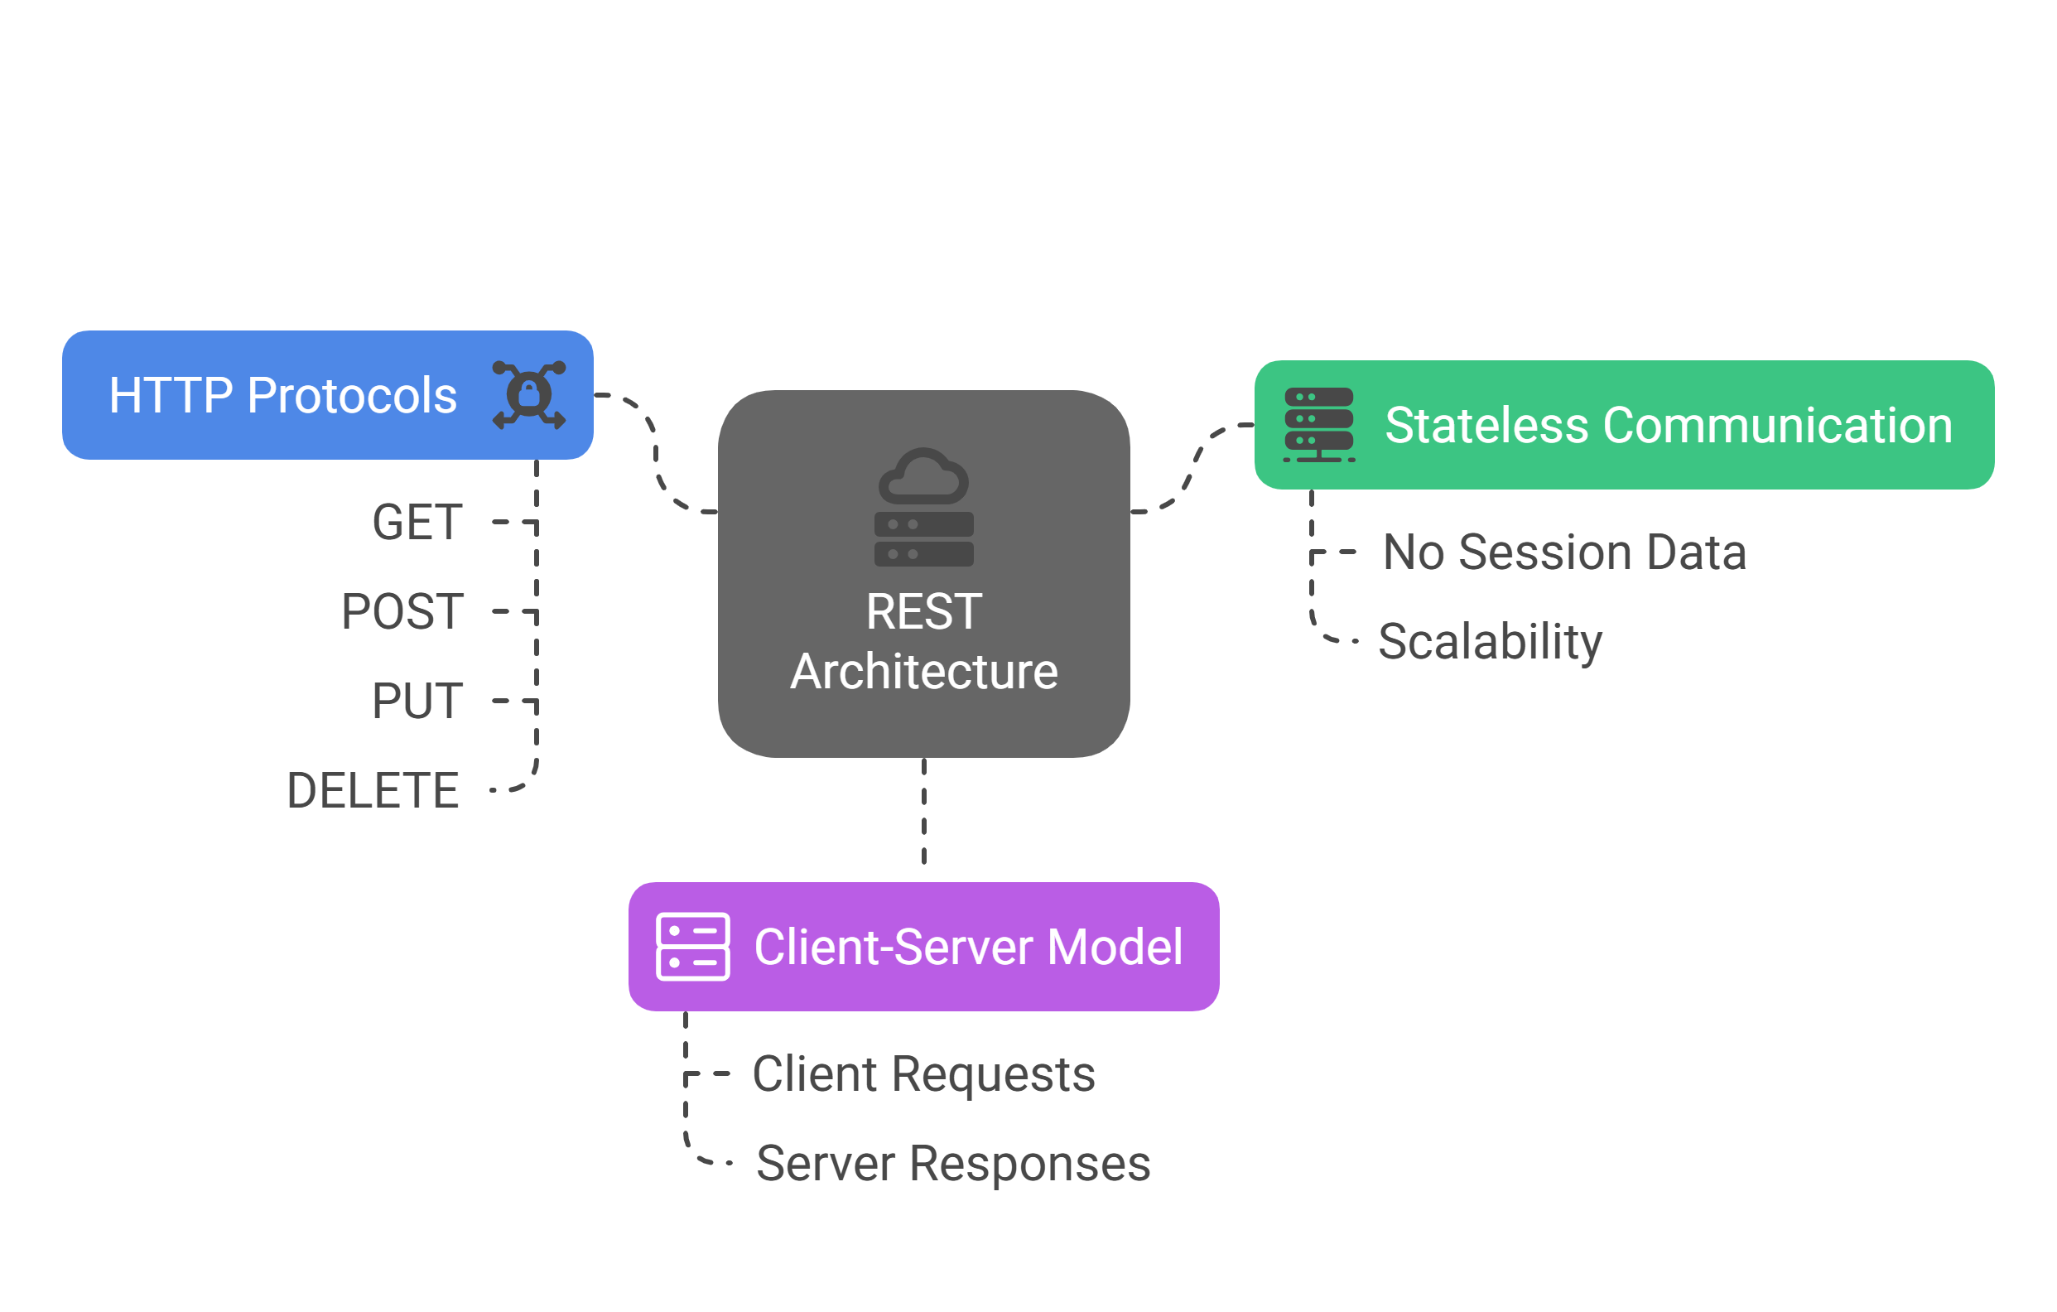
Introduction to REST
REST (Representational State Transfer) is an architectural style for designing networked applications.
It relies on stateless, client-server communication using standard HTTP protocols.

Slide 3
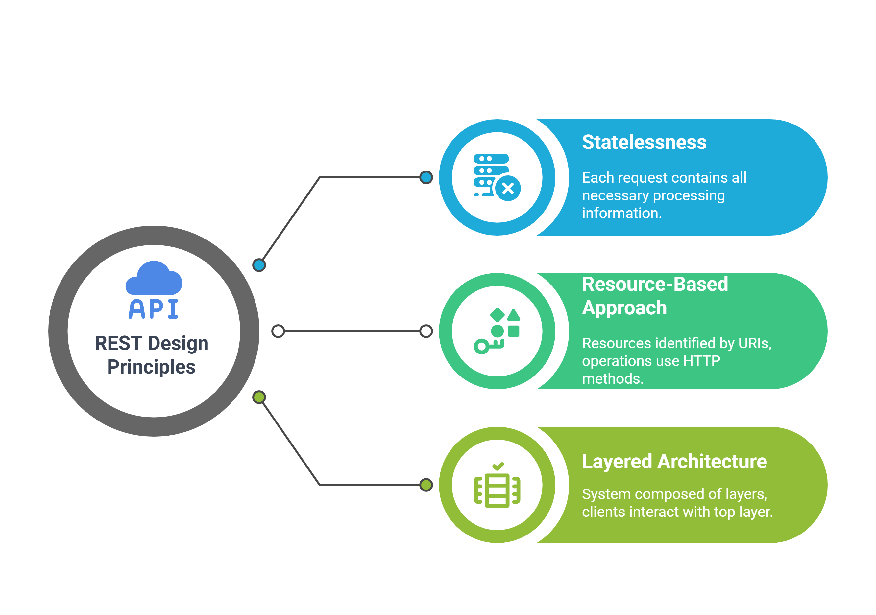
REST Design Principles

Slide 4
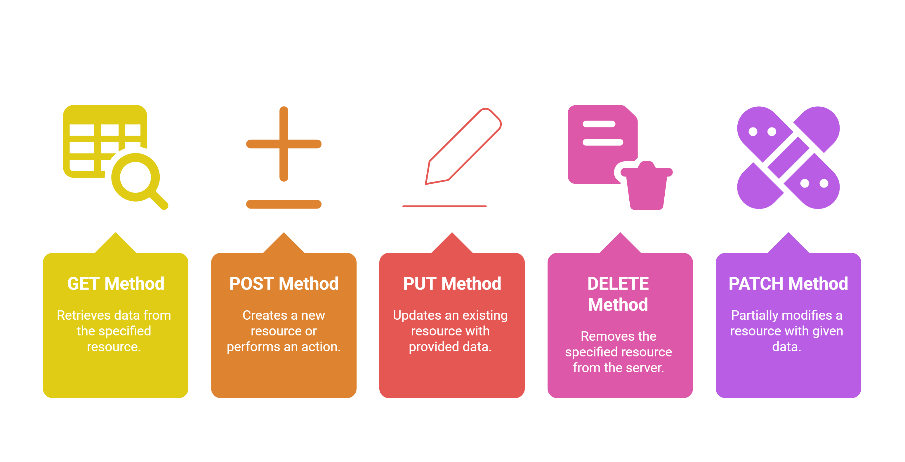
HTTP Methods
When to Use Each Method :
Use GET for read-only operations.
Use POST for creating resources or triggering actions.
Use PUT and DELETE for modifying or removing resources.

Slide 5
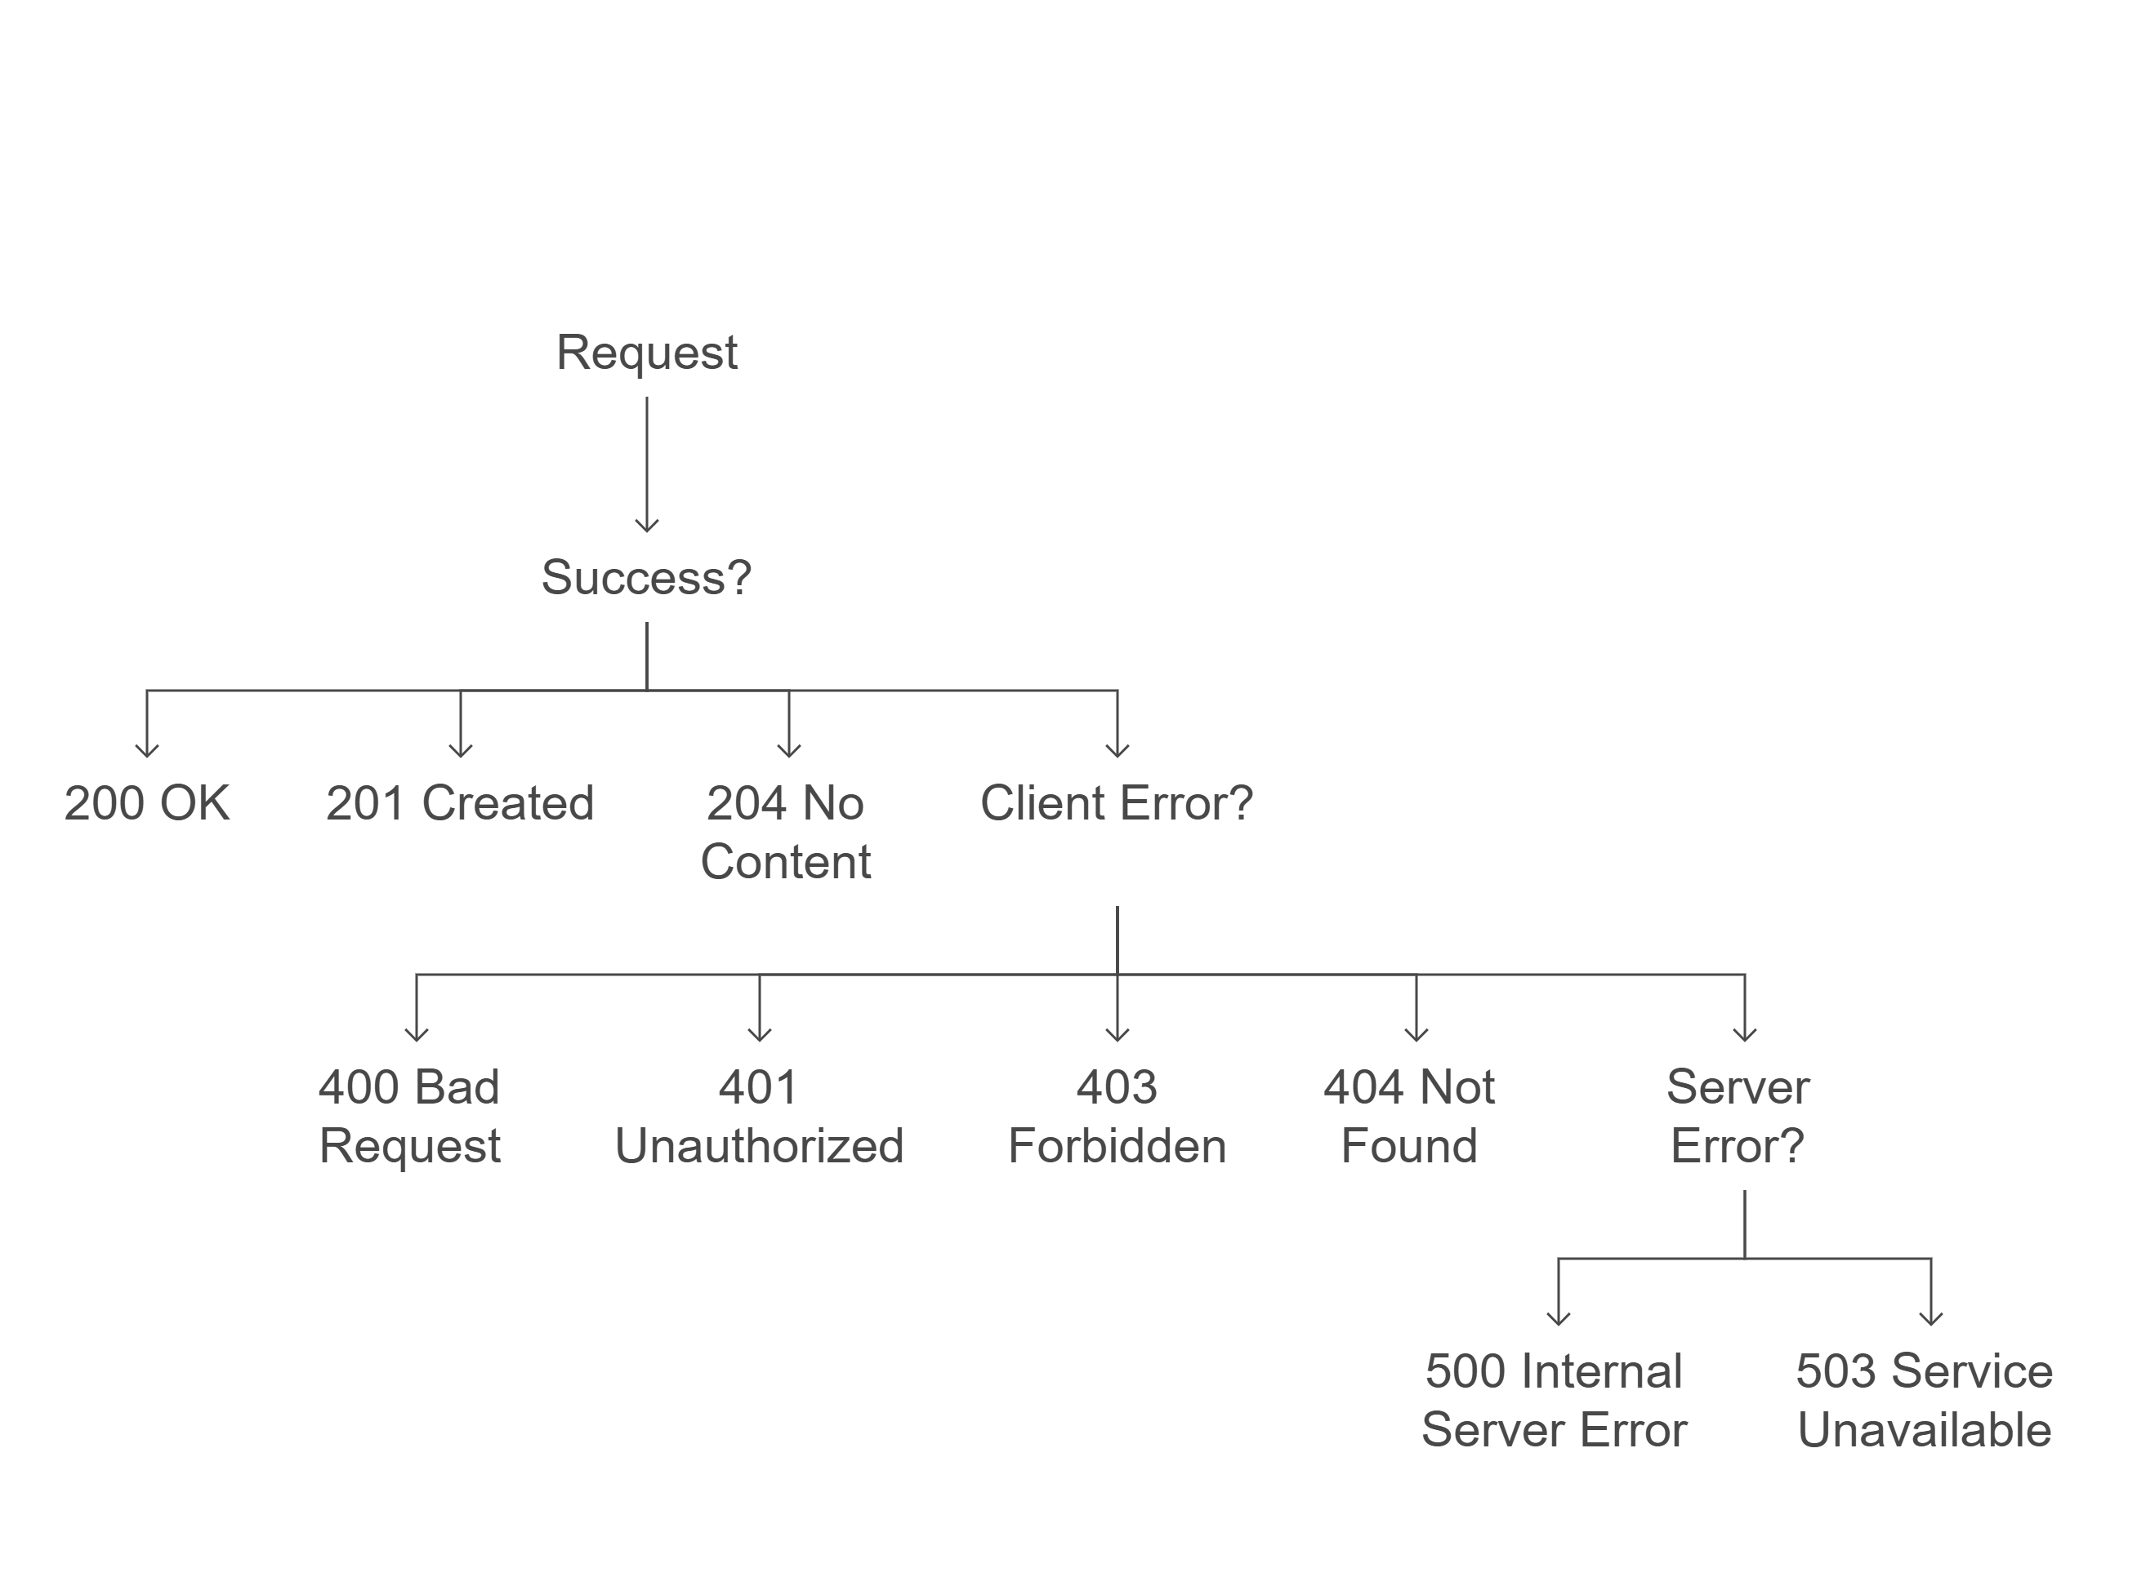
HTTP Response Codes

Slide 6
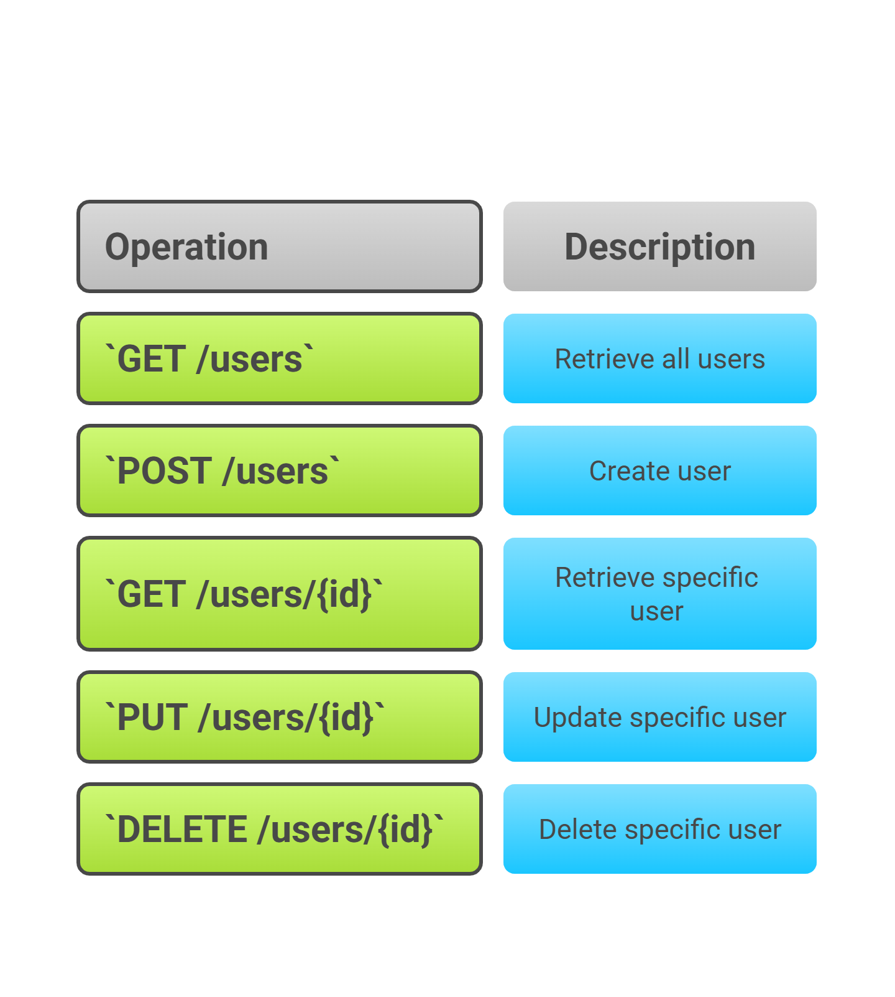
Resource Endpoints Examples
Best Practices :
Use nouns for resource names (e.g., /users, /products).
Avoid verbs in resource paths; use HTTP methods to define actions.

Slide 7

Transactional REST APIs
REST APIs that manage CRUD (Create, Read, Update, Delete) operations.
Characteristics :
Resource-based endpoints (nouns).
Standard HTTP methods (GET, POST, PUT, DELETE).
Requests and responses contain structured data (JSON, XML).
Errors include validation errors, permissions, and HTTP response codes.
Performance focuses on database optimization, caching, indexing.
Security includes authentication, authorization, and data protection.

Slide 8
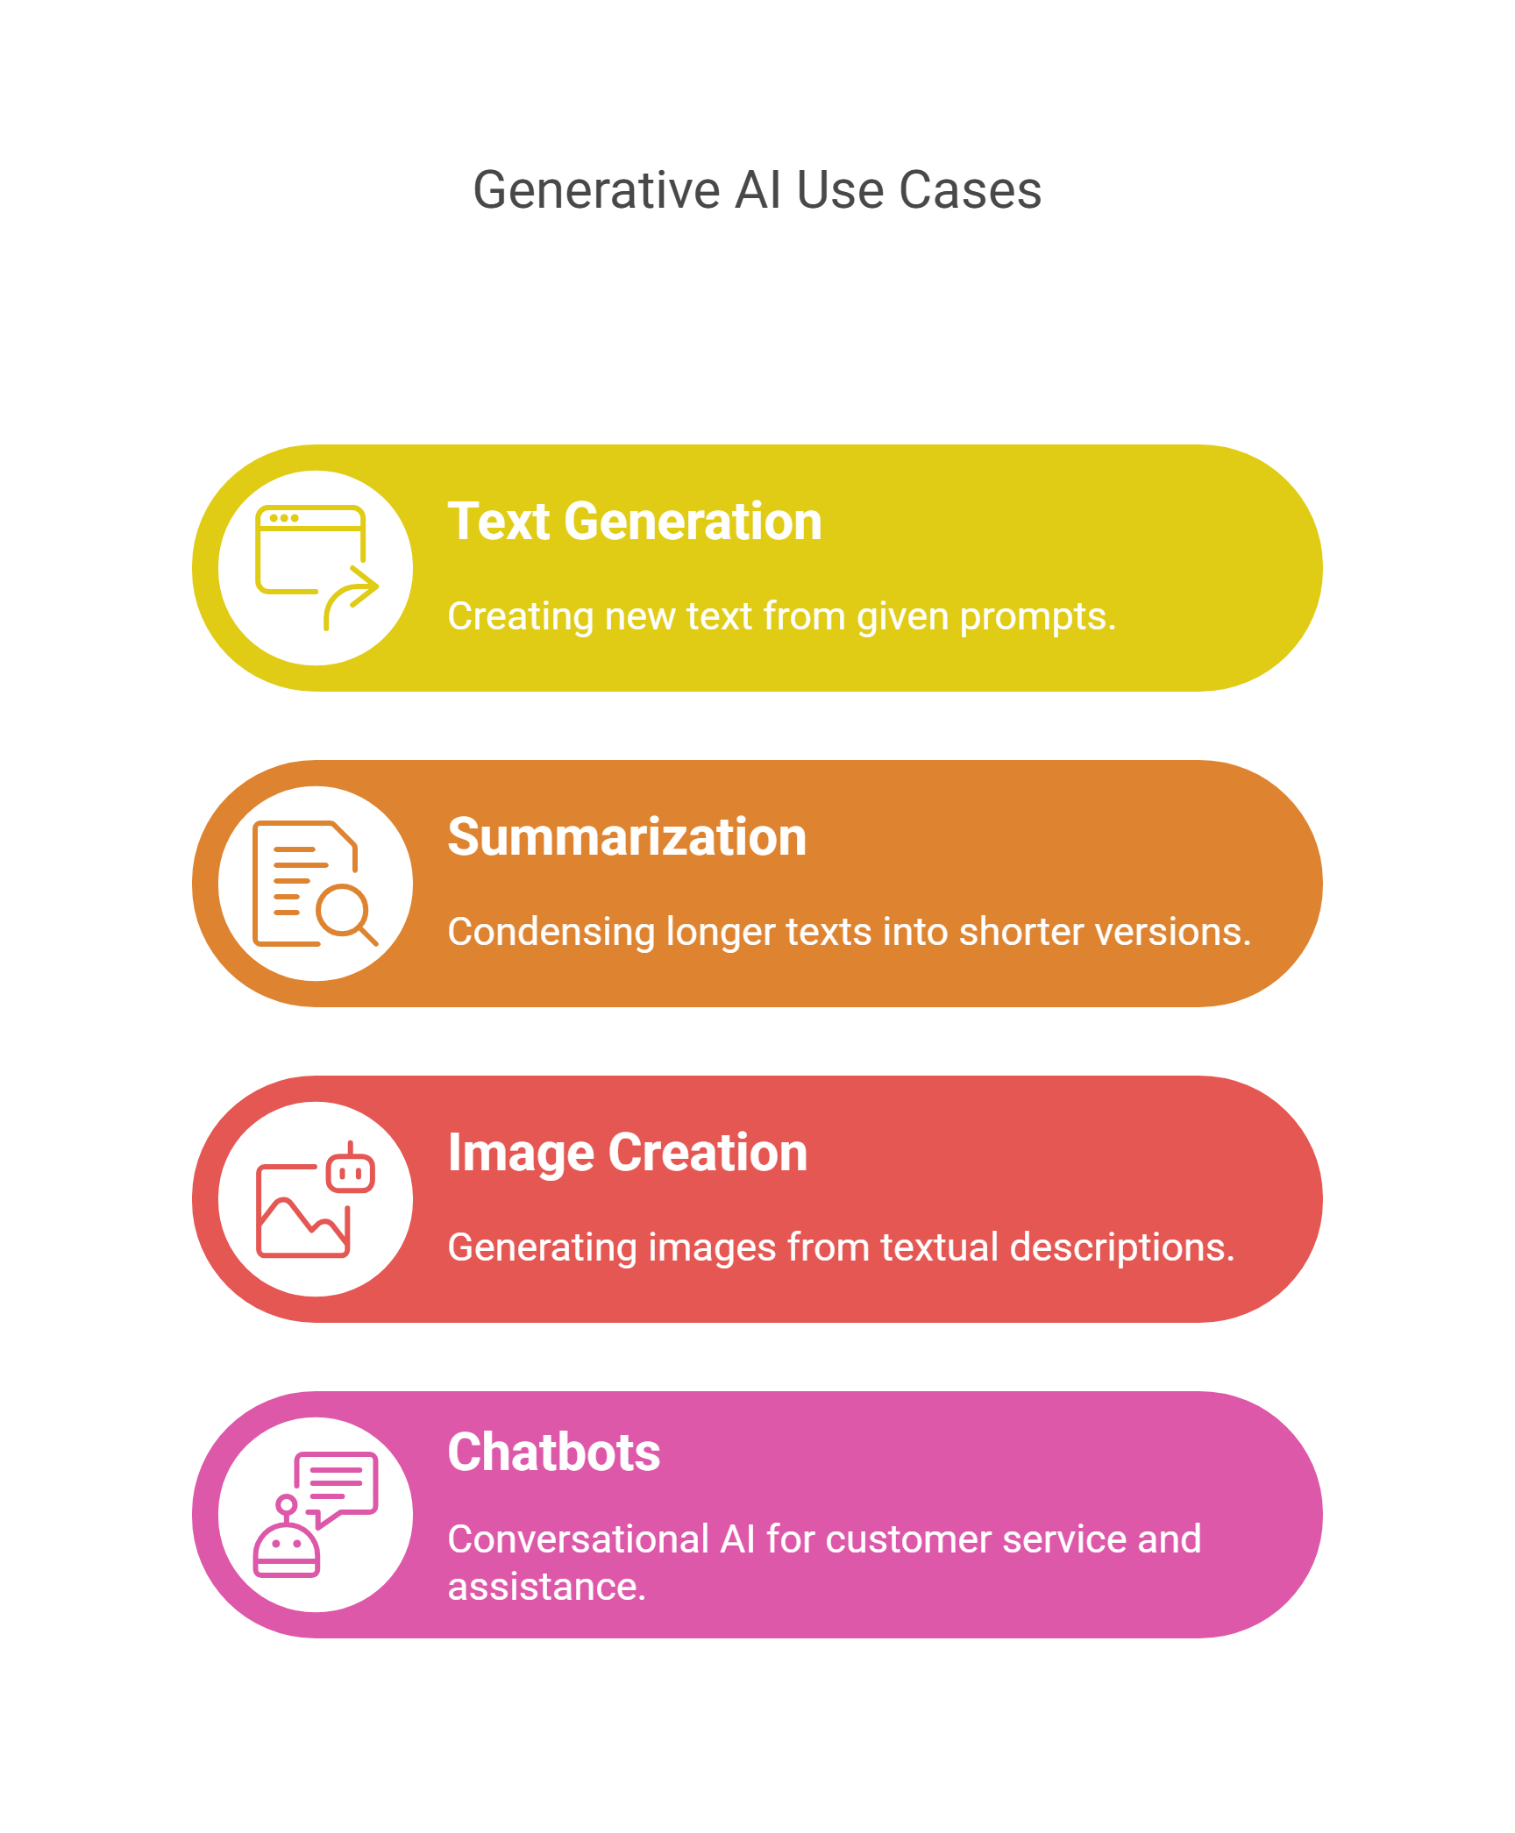
Generative AI REST APIs
REST APIs that generate content based on input prompts using AI models.
Characteristics :
Action-based endpoints (verbs).
Mostly uses POST requests to submit data (prompt + model parameters).
Responses include generated content and metadata.
Errors include model-specific information and custom error messages.
Performance focuses on model inference time and handling high computational loads.
Security includes API keys, rate limiting, and ensuring safe generated content.

Slide 9
Transactional REST APIs vs Generative AI REST APIs
Aspect | Transactional REST APIs | Generative AI REST APIs
Purpose | Manage CRUD operations | Generate AI-driven content
Endpoints | Noun-based (resource-oriented) | Verb-based (action-oriented)
HTTP Methods | GET,POST,PUT,DELETE | Primarily POST
Request/Response | Structured data (JSON,XML) | Prompt + model parameters → Generated content
Errors | Validation, permissions, HTTP codes | Model-specific info, custom messages
Performance Focus | Database optimization, caching | Model inference time, computational efficiency
Security | Authentication, authorization, data protection | API keys, rate limiting, safe content

Slide 10

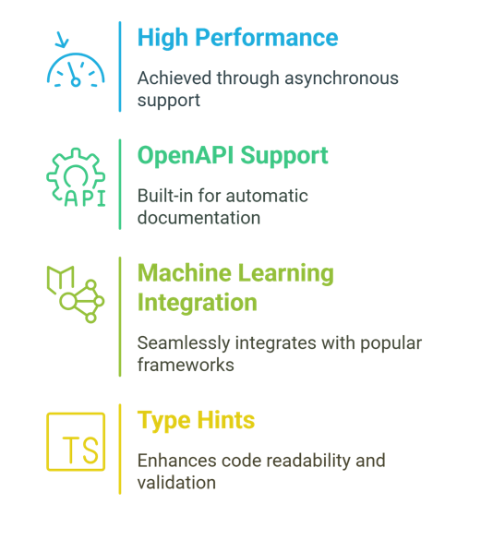
Why for Generative AI?
Advantages of Fast API :
High performance
Built-in support for automatic documentation.
Integration with Hugging Face, Open AI .. etc
Built-in Validations and Type Hints
Use Case Example :
Building a text generation API using Hugging Face models.
Example endpoint: POST /generate with request body containing prompt and model.

Slide 11

vs
Feature | FastAPI | Flask
Performance | Extremely fast due to asynchronous capabilities | Slower compared to FastAPI
Documentation | Automatic OpenAPI/Swagger docs | Requires manual setup or third-party plugins
Validation | Built-in Pydantic for type-safe validation | Requires external libraries (e.g., Marshmallow)
Asynchronous Support | Native async/await support | Limited async support (via extensions)
Ease of Use | Modern design with fewer boilerplate code | More verbose and requires additional libraries
Use Cases | AI/ML APIs, real-time systems, high-performance apps | General-purpose web apps, small projects

Slide 12
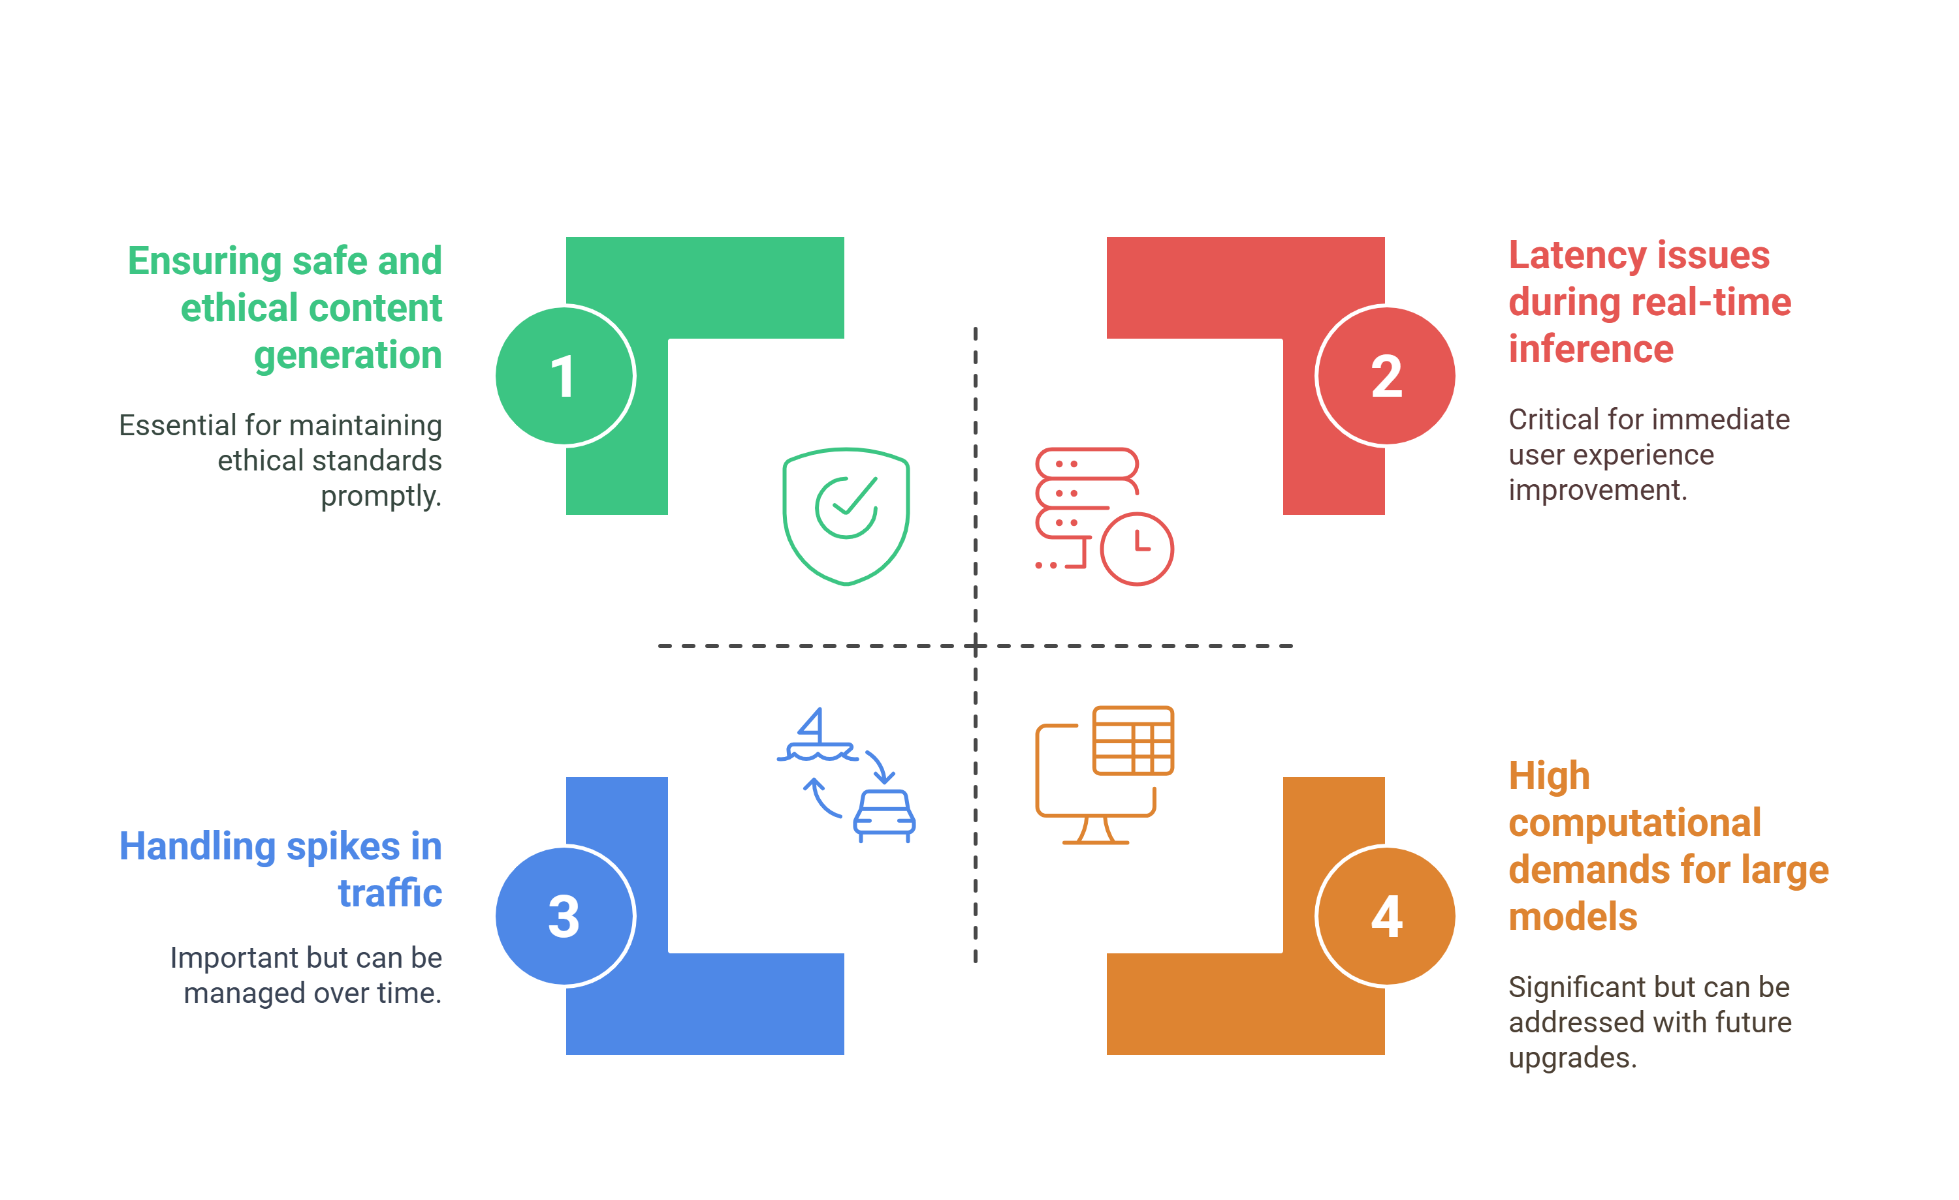
Challenges in Generative AI APIs

Slide 13
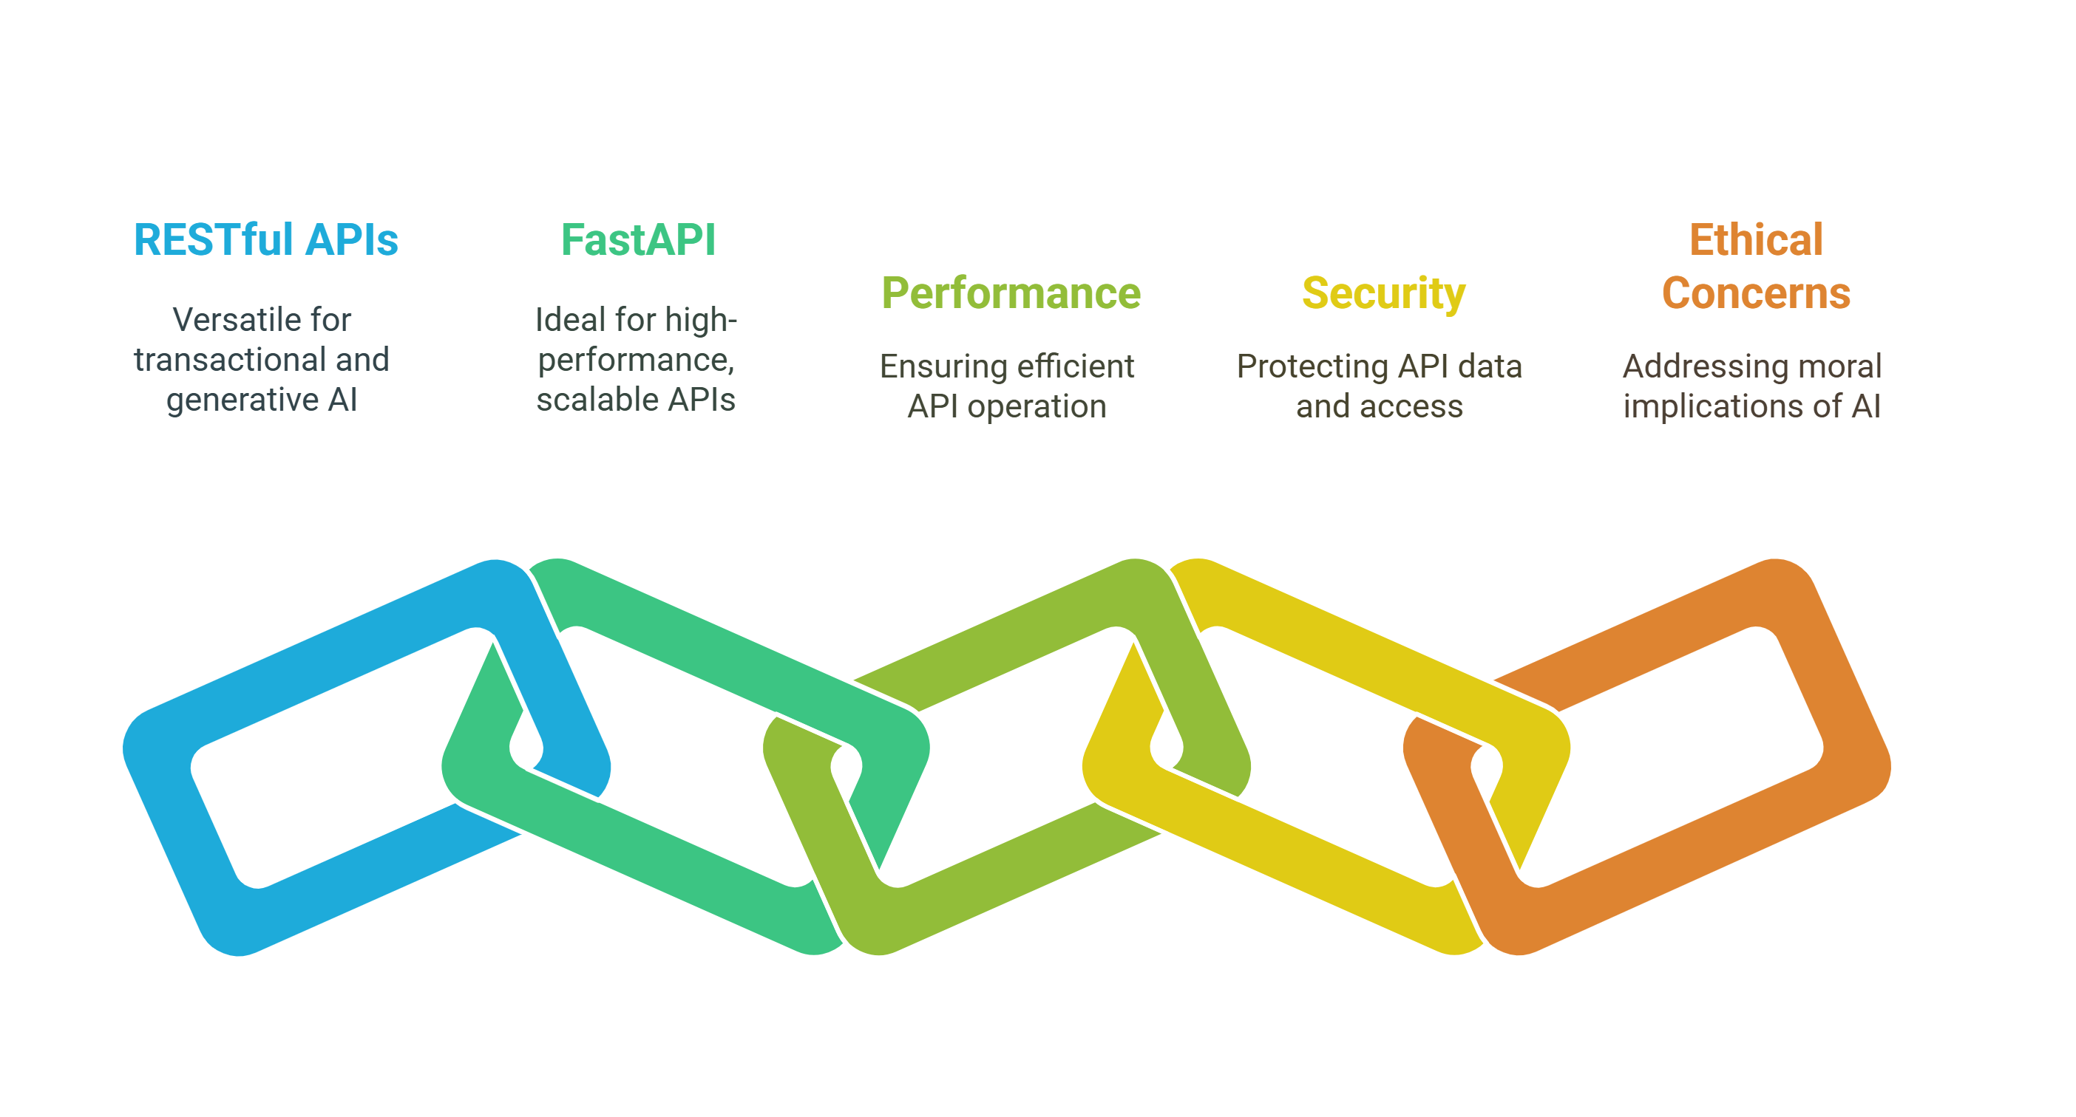
Conclusion
Summary :
RESTful APIs are versatile and can be used for both transactional and generative AI applications.
FastAPI is an excellent choice for building high-performance, scalable APIs.
Generative AI APIs require careful consideration of performance, security, and ethical concerns.
Future Directions :
Explore multi-modal AI APIs (text, images, audio).
Optimize deployment using tools like Kubernetes and GPU acceleration.

Slide 14
Q&A

